Slide 1
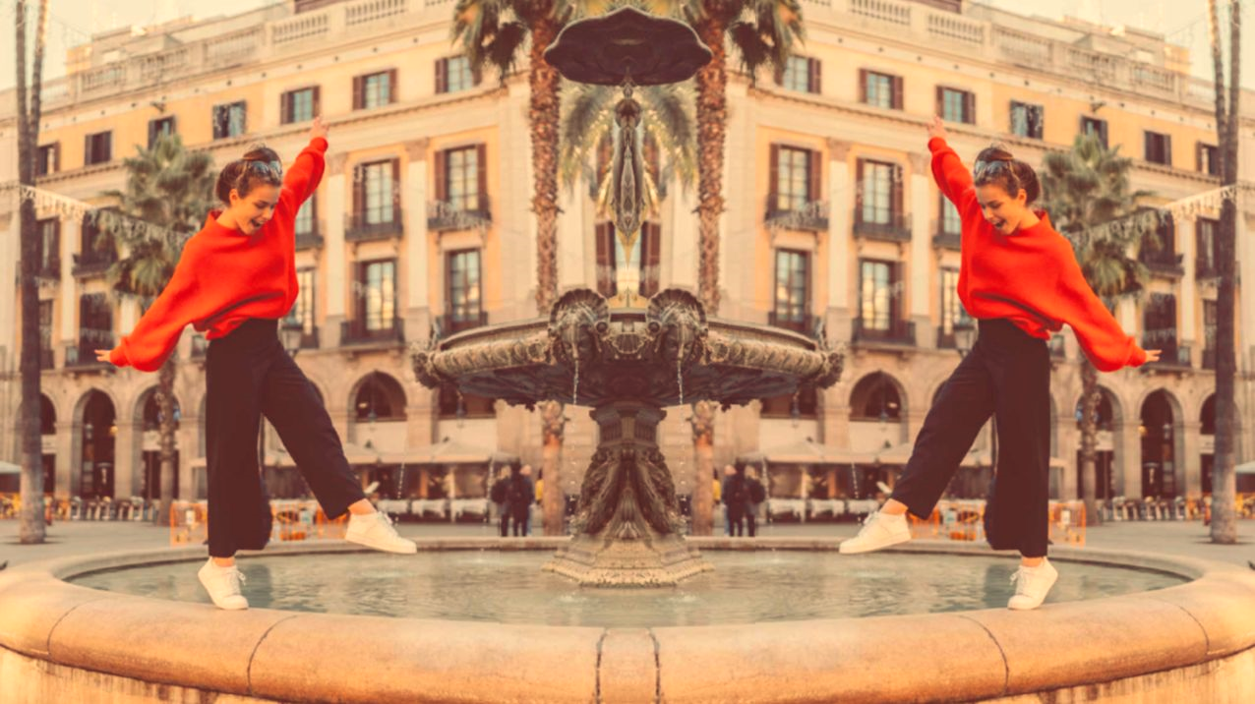
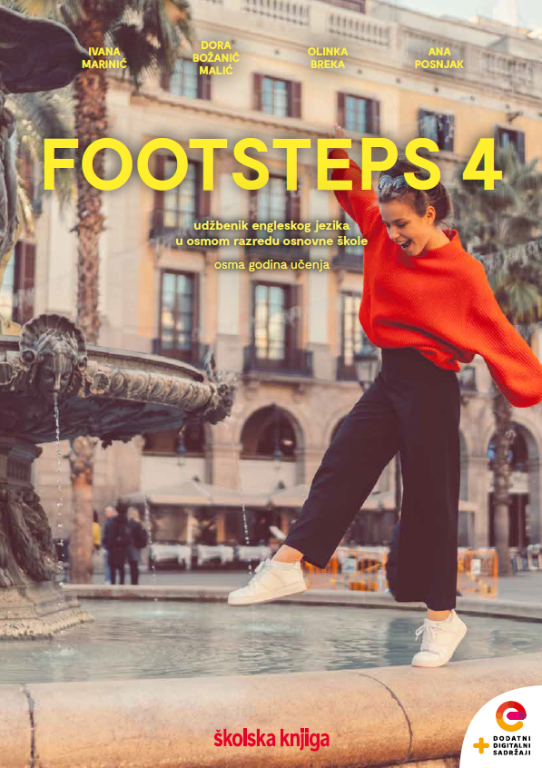
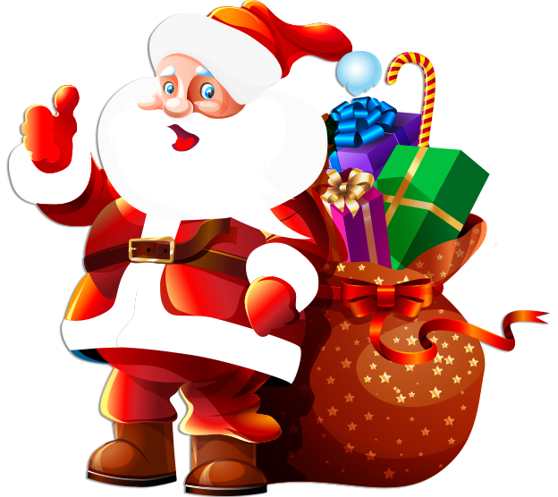

Holidays:
Christmas

Slide 2






Remember the words connected to Christmas.
You can also use this https://wordart.com/
presents
reindeer
Santa
CHRISTMAS
When do we celebrate Christmas?

Slide 3
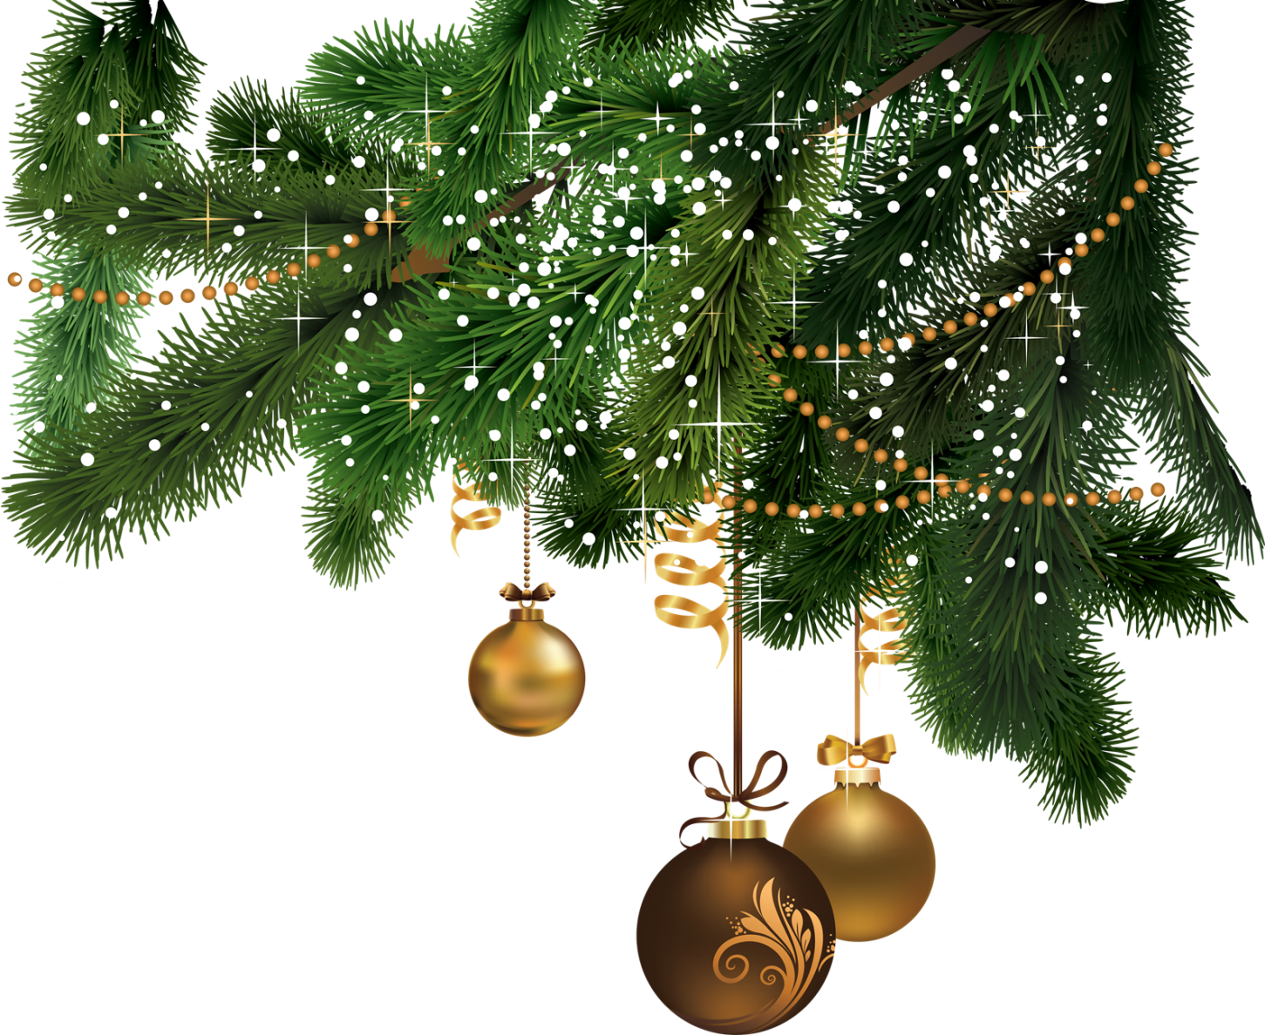
Check your vocabulary.
https://wordwall.net/play/8830/995/182
How do we celebrate Christmas?
Christmas is celebrated all over the world on the 25th of
December. It is the time of joy, faith and a day on which we
celebrate the birth of Jesus Christ.
The streets and shops are full of lights and Christmas ornaments.
Christmas in England is a family event.
Families decorate a Christmas tree and people put a mistletoe over the main door. Mistletoe brings good luck and British people kiss their friends and family under the mistletoe.
Children usually get up early because they are excited. After all, during the night Father Christmas (also known as Santa Claus) has left gifts for them. Father Christmas comes into the house through the chimney and leaves his gifts in big socks (Christmas stockings) or under the Christmas tree.

Slide 4
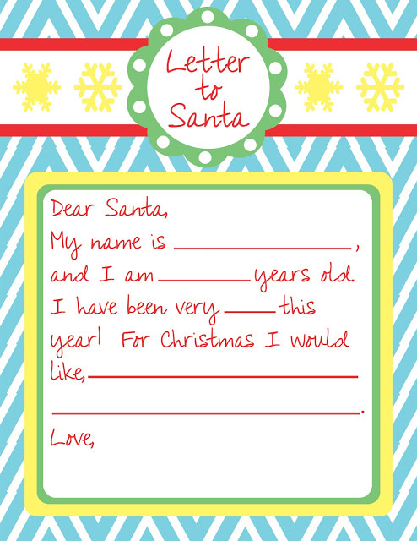
What would you like to get for Christmas?
Write a letter to Santa.

Slide 5
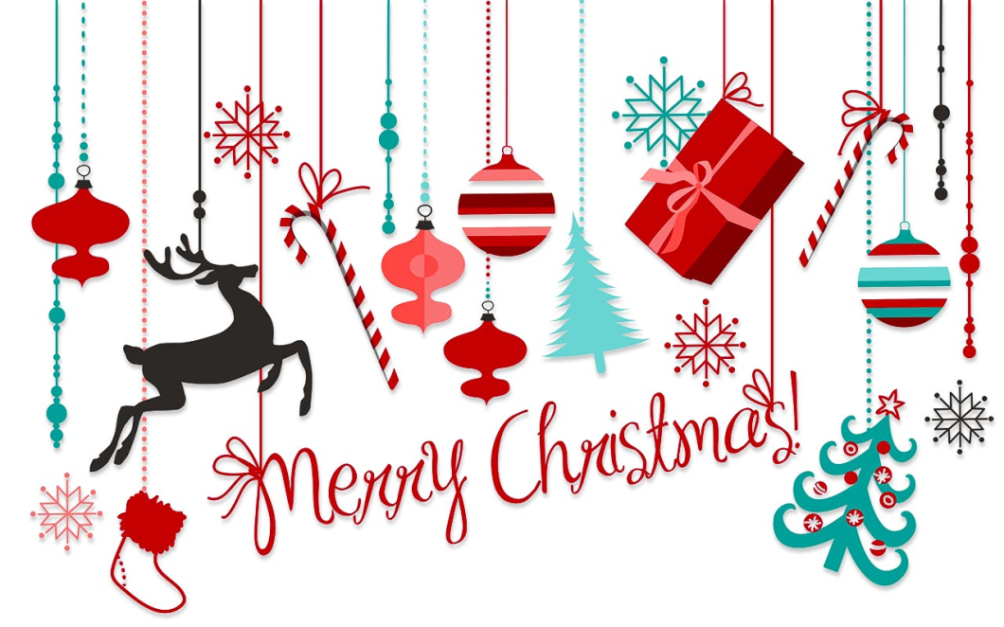
On Christmas Day British people eat a special Christmas Dinner. They usually have
roast turkey with carrots, potatoes, peas and gravy. Then after the turkey, there’s
Christmas pudding, a special delicious dessert.
People usually sing traditional Christmas songs called carols.
Do you know any carols? Check the links.
https://youtu.be/g-OF7KGyDis
https://youtu.be/3CWJNqyub3o
https://youtu.be/nEH7_2c644Q
https://youtu.be/FuAHR4lkjCo https://wordwall.net/resource/26658409
https://youtu.be/A9eo-Dgf1EA https://wordwall.net/resource/26659004

